Slide 1
Agile Values and Principles
-Sunny Barve

Slide 2
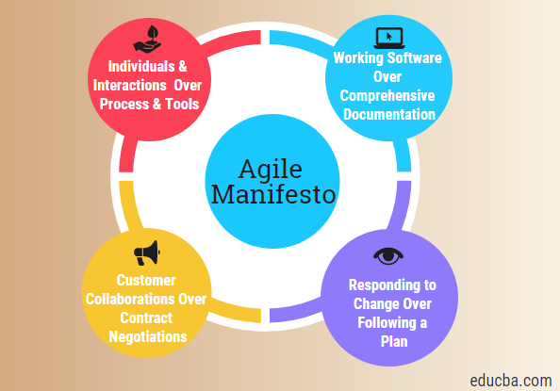
The Four Values of Agile
Individuals and interactions over processes and tools: Prioritize effective communication and collaboration among team members.
Working software over comprehensive documentation: Focus on delivering a functional product rather than excessive documentation.
Customer collaboration over contract negotiation: Build strong relationships with customers and involve them in the development process.
Responding to change over following a plan: Embrace change and adapt to evolving requirements.

Slide 3
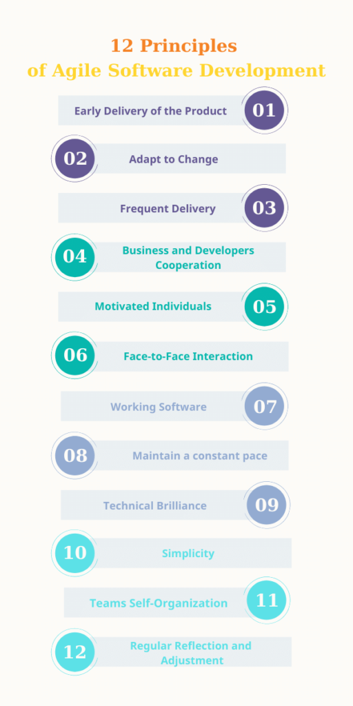
Agile Principles
Customer satisfaction: Deliver valuable software early and continuously.
Welcome changing requirements: Embrace changes throughout the development process.
Frequent delivery of working software: Deliver working increments of software frequently.
Collaboration between stakeholders: Foster collaboration among stakeholders.
Support people and trust them: Empower team members and trust their abilities.
Face-to-face interactions: Prioritize face-to-face communication within the team.

Slide 4
Agile Principles
Measuring software progress: Track progress using objective measures.
Sustainable development: Maintain a sustainable pace of development.
Attention to technical excellence: Continuously improve technical practices.
Simplicity: Keep things simple and avoid unnecessary complexity.
Self-organizing teams: Empower teams to make decisions and manage their work.
Regular reflections: Regularly reflect on how to become more effective.

